Slide 1
Data mining on Georgian Conflict
Data Scientists: Cecilia Reyes, Michael Piccirilli, Rumya Raghunath, Victoria C. Nneji
Notes:
Insert pictures with names

Slide 2




The Team
Michael
Statistics
Victoria
Applied Math
Cecilia
Computer Science
Rumya Public Health

Slide 3

Recap …

Slide 4

Actor Discovery - introduction
Notes:
SAAKASHVILI MIKHEIL
VASHADZE GRIGOL
EKA TKESHELASHVILI
BAKUR KVEZERELI MIKHEIL SAAKASHVILI
EDUARD SHEVARDNADZE MIKHEIL SAAKASHVILI
BEZHUASHVILI GELA
MIKHEIL SAAKASHVILI LADO GURGENIDZE
MIKHEIL SAAKASHVILI BAKUR KVEZERELI
NINO BURJANADZE NINO BURJANADZE
ZURAB NOGAIDELI ZURAB NOGAIDELI

Slide 5
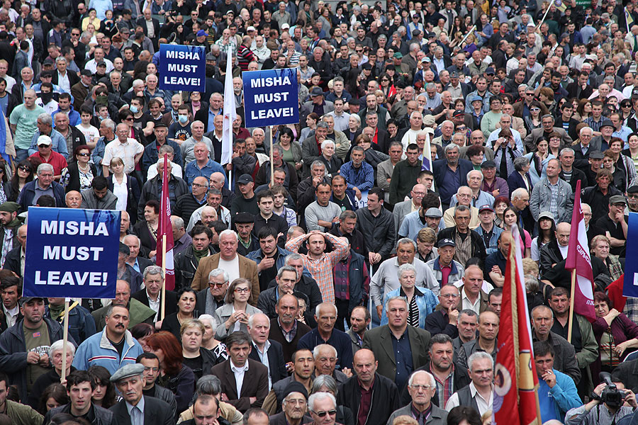
Recap …

Slide 6

Recap …

Slide 7
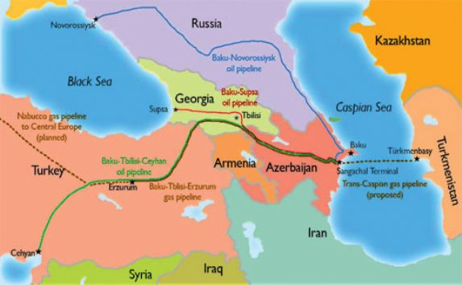
Notes:
Do we have a nicer, higher rez map?

Slide 8
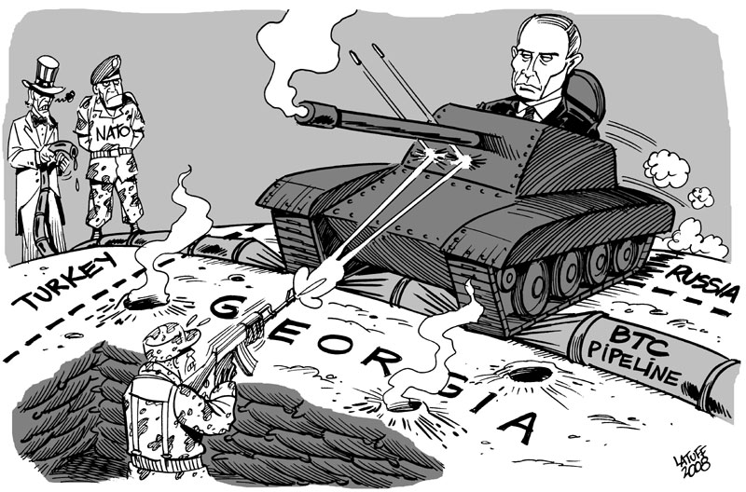

Slide 9
Understanding the context,
we can make better sense of the exploratory data.

Slide 10
HYPOTHESIS: aN actor’s past interactions with another will remain consistent in the future.

Slide 11
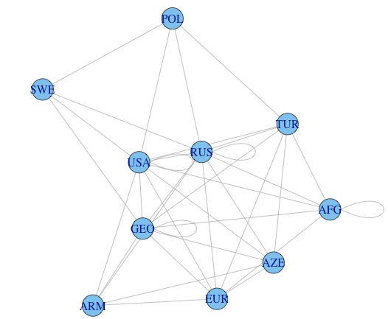
Process and Challenges
Events occurring in Georgia
Georgia != Georgia
Big Data? Meh.
Limited features
Focused on Event Types
Goal: Predict an event between actors
Notes:
Given our hypothesis, that relationships between actors stay the same over time, we decided it would might be appropriate to use markov chains

Slide 12
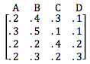
Markov Chains
Stochastic Process
Markov Property – “Memoryless” random process
Dependent on current position
Transition Matrix
Notes:
Stochastic process: often used to represent the evolution of some random value, or system, over time
A system that undergoes transitions from one position to another, among a finite or countable number of possible position.
It is a random process usually characterized as memoryless – meaning the next position depends only on the current position and not on the sequence of events that preceded it. This specific kind of "memorylessness" is called the Markov property.
The changes of position of the system are called transitions, and the probabilities associated with various position changes are called transition probabilities. The process is characterized by a transition matrix describing the probabilities of particular transitions.

Slide 13
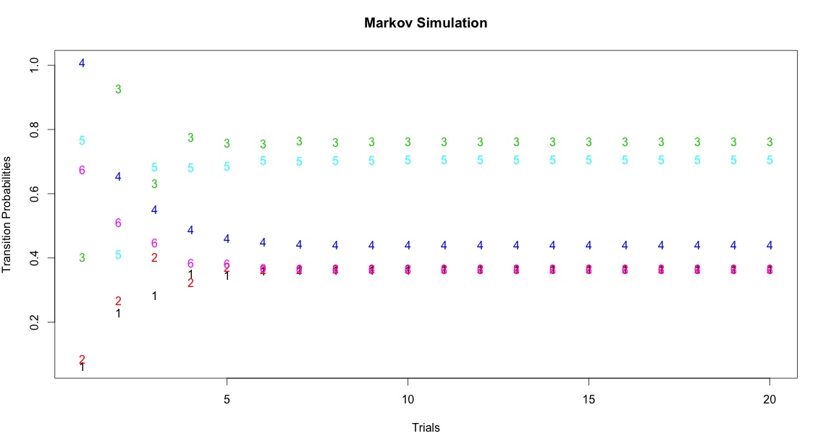

Slide 14
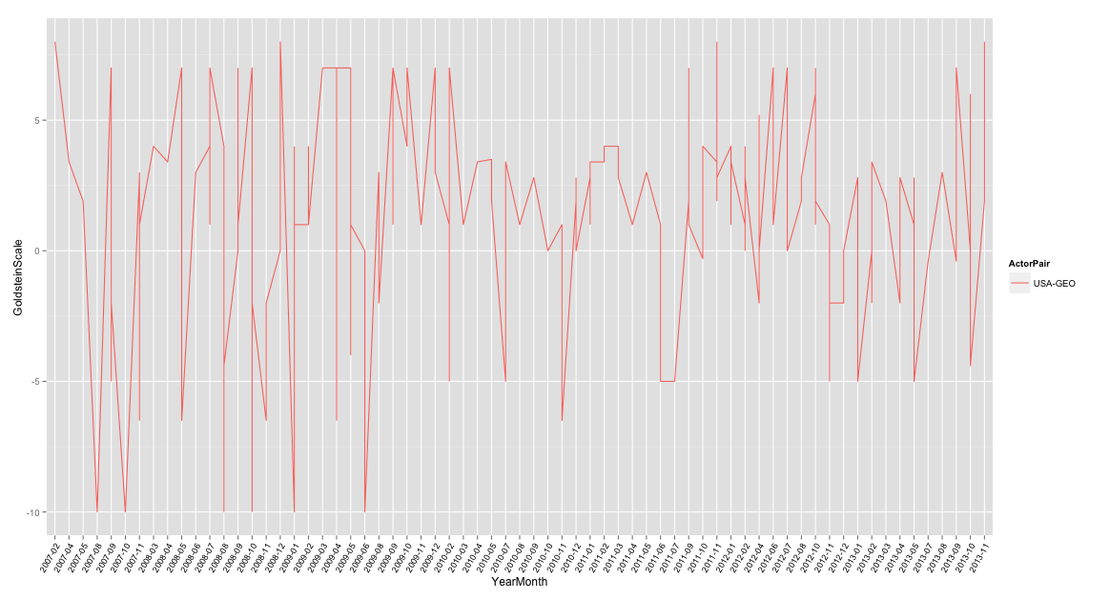

Slide 15
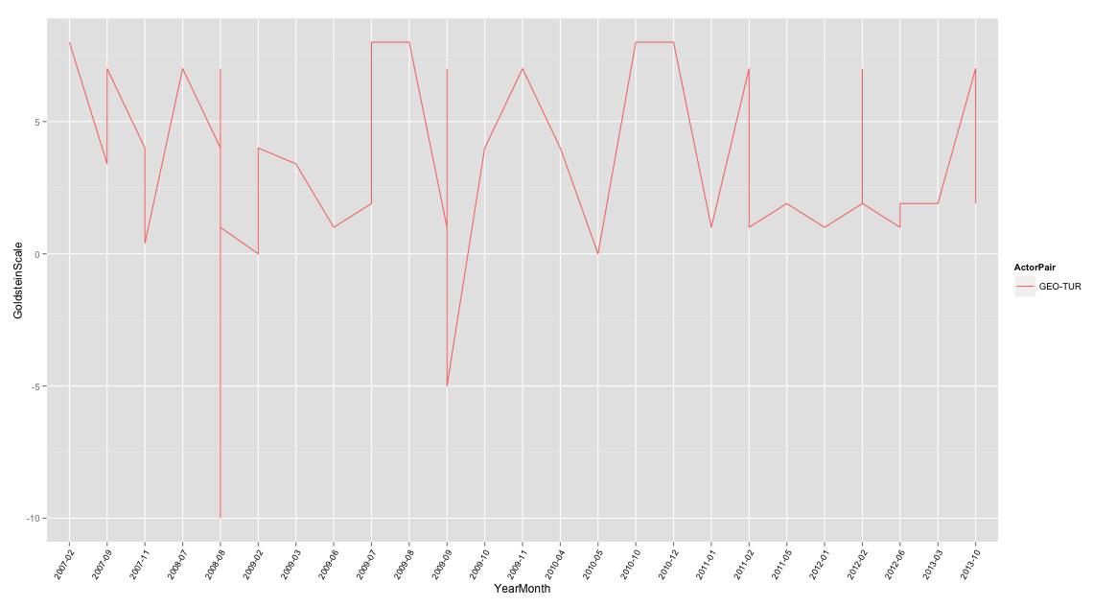

Slide 16
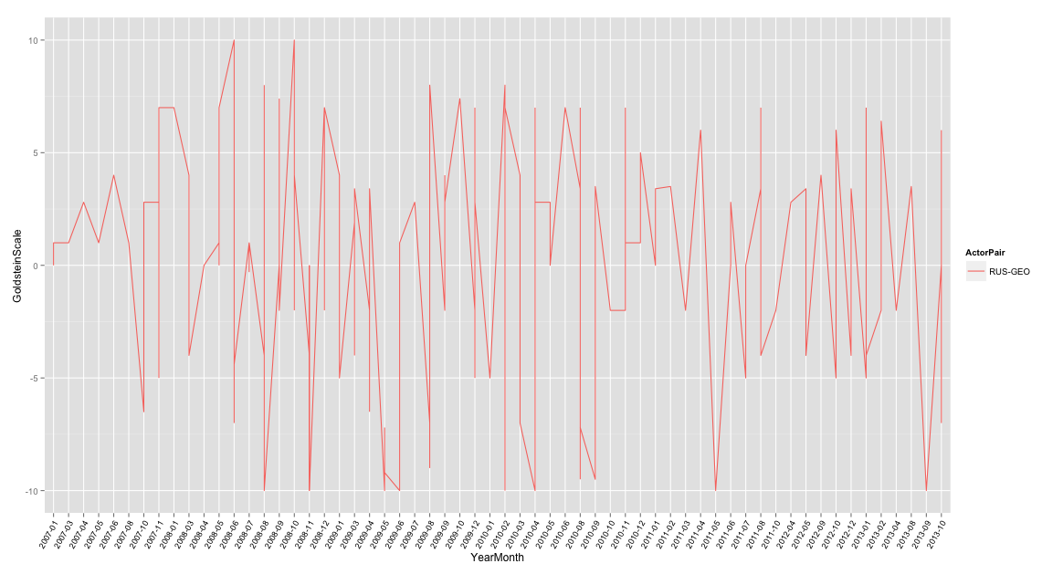

Slide 17
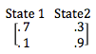
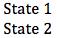
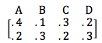
Hidden Markov Model (HMM)
Dependent on the current state
Transition Matrix and Emission Matrix
HMM transition matrix: Probabilities of changing states
Emission matrix: Probabilities of each position within each state

Slide 18
How well does it predict?
GOOD QUESTION!

Slide 19
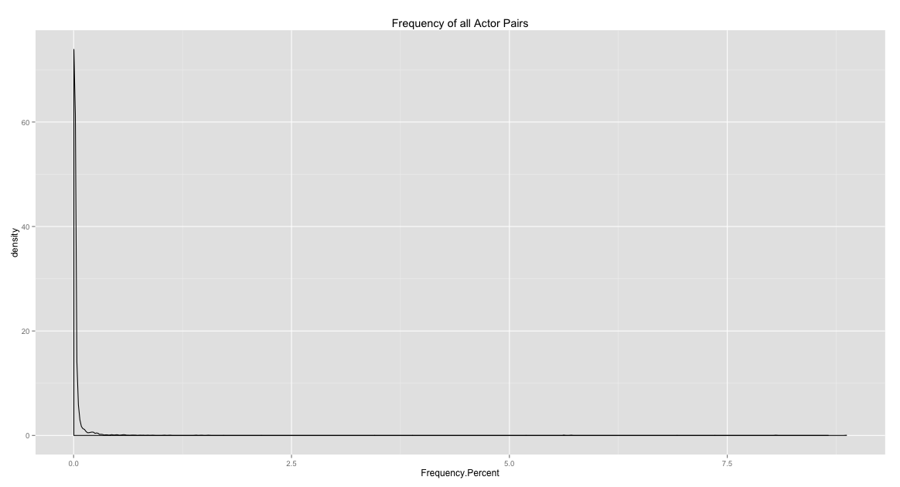

Slide 20
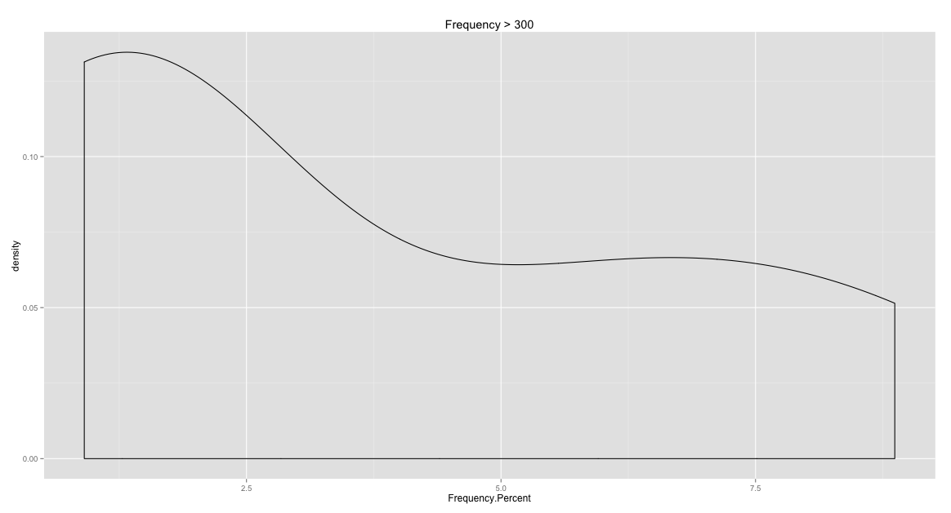

Slide 21
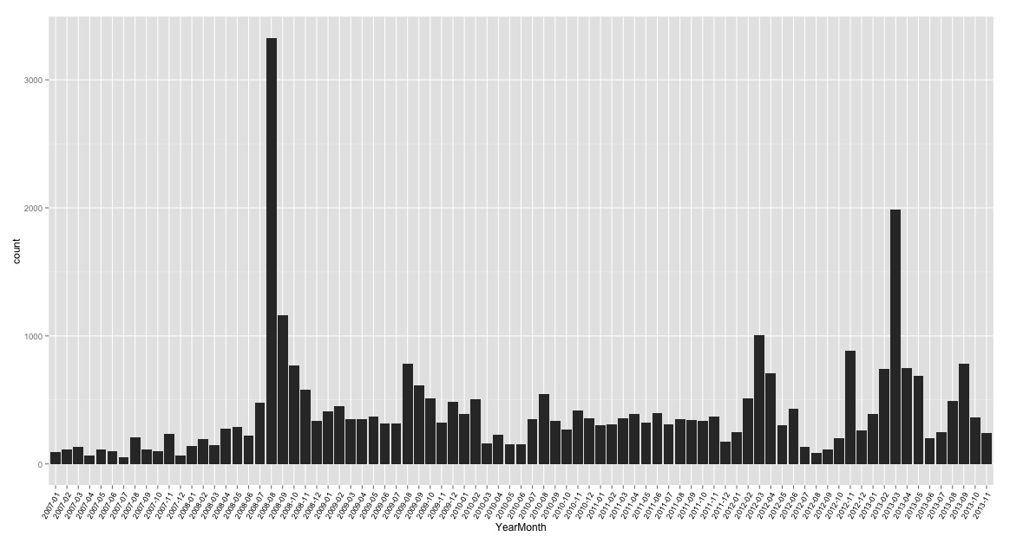
Observations
Number of Articles
January 2007 to November 2013

Slide 22
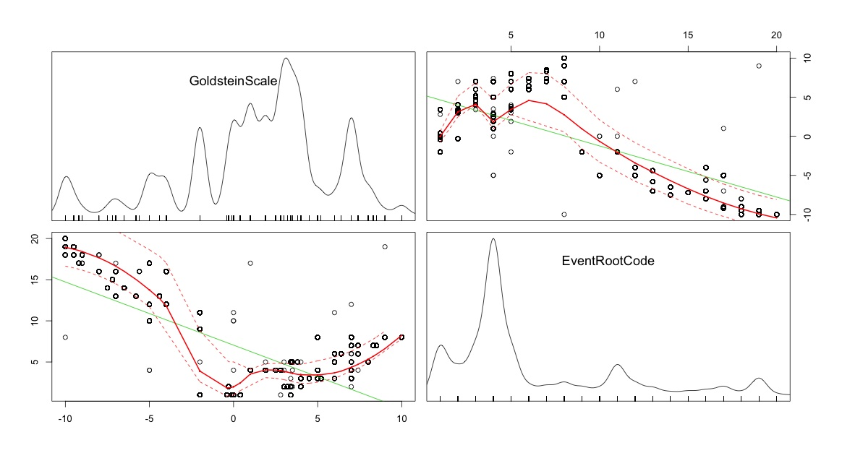
Observations (cont’d)
Cross Matrix
Goldstein Scale vs. Event Root Code

Slide 23
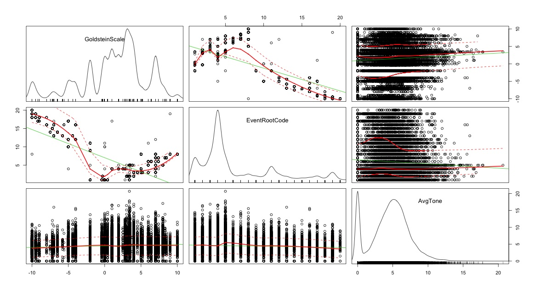
…more observations…
Cross Matrix
Goldstein Scale vs. Event Root Code vs. Average Tone

Slide 24
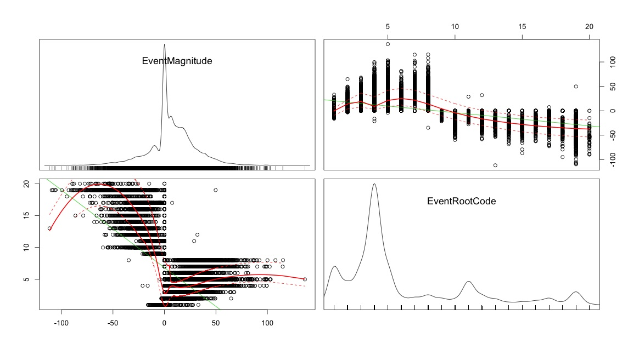
Event Magnitude
Cross Matrix
Event Magnitude* vs. Event Root Code
*(GoldsteinScore x AvgTone)

Slide 25
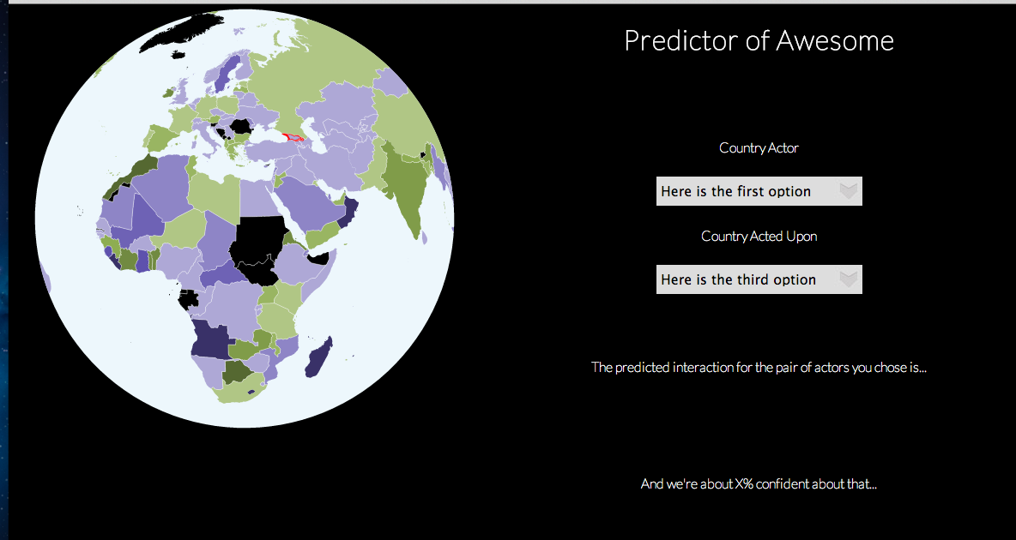
Developing the Data Product
There were several layers to our final design.

Slide 26
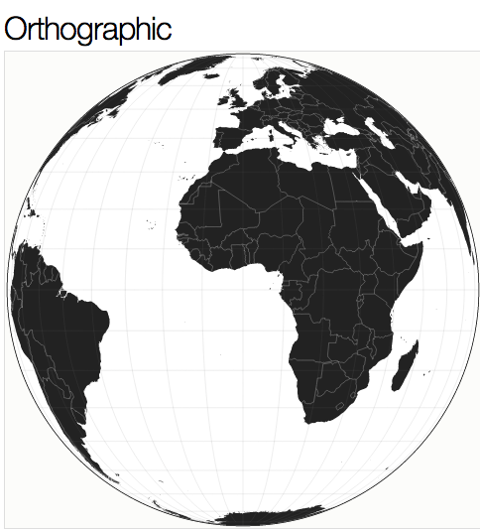
D3.js + jQuery + HTML/CSS = [suspense]
MAP
Use topoJSON file to create the map as an SVG element
Choose the right projection and scale
“orthographic” in this case

Slide 27
D3, how does it work?*
*magic
COLORS
Load in csv file with the ISO codes (map)
Map domain of ratios with range of colors
(i.e. higher ratios with deeper purples, etc)
Use Hashtable-esque implementation
INTERACTIONS
When county selected, pass ISO code to the map
style with appropriate color (from csv/hash)
Pull in associated prediction with both actor choices
FUTURE: backend?
Profit

Slide 28


Slide Show Tips

Slide 29


Slide 30


